Slide 1
Session 9, FILTERS
Filter
<number>/41

Slide 2
Objectives
Introduction to Filter
+ Understand the purpose of Filter
+ Create, Declaring and Mapping Filter
+ Ordering Filter Properly
Filter
<number>/41

Slide 3
What is Filter?
Filter is a small program that run on the server before the servlet or JSP page with which it is associated.
Filter can be attached to one or more servlets or JSP pages and can examine the request information going into these resources.
Filter can Invoke the resource in normal manner.
Filter can Invoke the resource with modified request information.
Filter can Invoke the resource but modify response before sending it to the client.
Filter can Prevent resource from being invoked and instead redirect to a different resource, return a particular status code, or generate replacement output.
Filter
<number>/41

Slide 4
What it can be used for ?
Authentication blocking request based on user identity.
Logging and auditing – Tracking uses of a web application.
Image Conversion – Scaling maps and so on.
Data Compression – Making downloads smaller.
Localization – Targeting a request and response in particular locale.
XSL/T Transformation of XML content
Filter
<number>/41

Slide 5
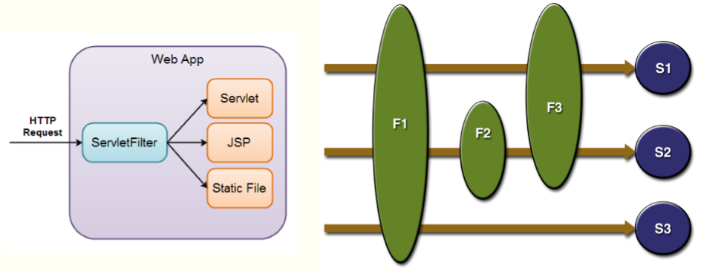
One or many filters
Filter
<number>/41

Slide 6
Creating a Basic Filter
Create a class that implements the Filter Interface. [ init, doFilter , destroy ]
Put the filtering behavior in the doFilter method.
Call the doFilter method of the FilterChain object.
Register the filter with the appropriate servlets and JSP page.
Disable the invoker servlet. **
Filter
<number>/41

Slide 7
Create a class that implements the Filter Interface
Must implement javax.servlet.Filter
public void init(FilterConfig config) throws ServletException
public void doFilter(ServletRequest request, ServletResponse response, FilterChain chain) throws ServletException, IOException Executed each time servlet is invoked.
FilterChain is used to invoke next filter that is associated with the servlet or jsp page, if no more filters it will invoke servlet or jsp page itself.
public void destroy()
Filter
<number>/41

Slide 8
Register the Filter
Use filter and filter-mapping tags to register filter in servlet.
  <filter>
  <filter-name> … </filter-name>
  <filter-class> … </filter-class>
  </filter>
  <filter-mapping>
  <filter-name> … </filter-name>
  <url-pattern> … </url-pattern>
  </filter-mapping>
Filter
<number>/41

Slide 9
Understanding filter and mapping tags
In filter element we can have icon, filter-name, display-name, filter-class, init-param.
In filter-mapping element filter-name, url-pattern, servlet-name, dispatcher.
dispatcher : Optional used to specifies what type of request this filter-mapping should apply to.
Possible values are REQUEST, FORWARD, INCLUDE and ERROR
Filter
<number>/41

Slide 10
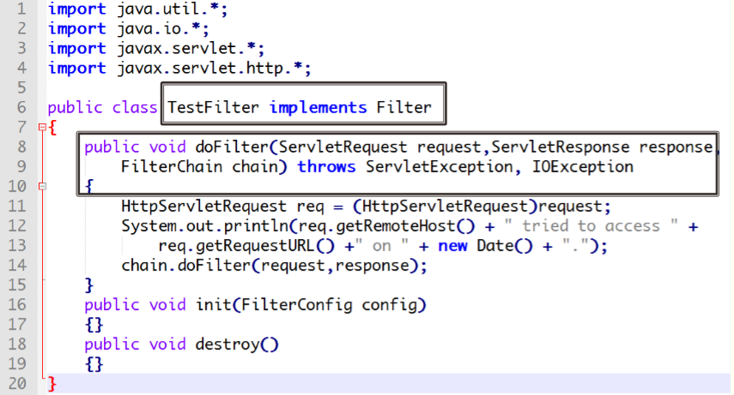
Example : Reporting Filter
Filter
<number>/41

Slide 11
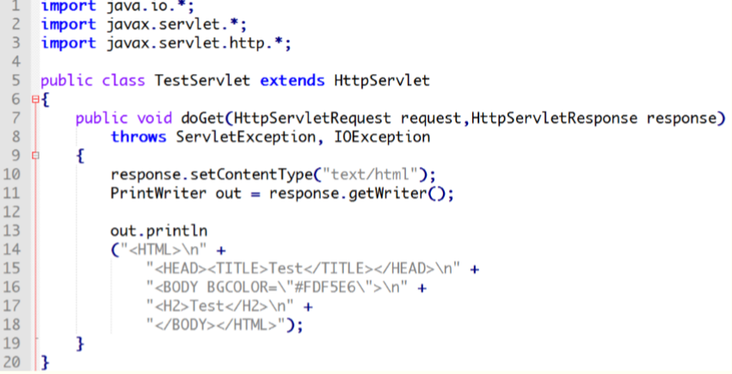
Example : Reporting Filter
Code for Servlet
Filter
<number>/41

Slide 12
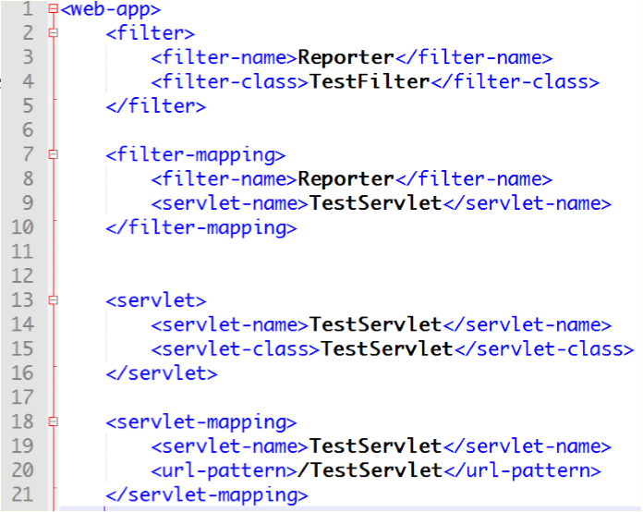
Example : Reporting Filter
Web.xml
Filter
<number>/41

Slide 13
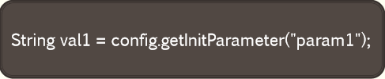
Initialization Parameter in Filter
Developers, End Users, Deployers
  <filter>
  <filter-name>SomeFilter</filter-name>
  <filter-class>somePackage.SomeFilterClass</filter-class>
  <init-param>
  <param-name>param1</param-name>
  <param-value>value1</param-value>
  </init-param>
  </filter>
Filter
<number>/41

Slide 14

Blocking the Response (1)
What we do in a filter
public void doFilter(ServletRequest request,ServletResponse response, FilterChain chain) throws ServletException, IOException { HttpServletRequest req = (HttpServletRequest)request; context.log(req.getRemoteHost() + " tried to access " + req.getRequestURL() +" on " + new Date() + "."); chain.doFilter(request,response);
}
Filter
<number>/41

Slide 15
Blocking the Response (2)
public void doFilter(ServletRequest request,ServletResponse response, FilterChain chain) throws ServletException, IOException { HttpServletRequest req = (HttpServletRequest)request; context.log(req.getRemoteHost() + " tried to access " + req.getRequestURL() +" on " + new Date() + "."); if(condition==true)
response.sendRedirect(“some other page /site”); else
chain.doFilter(request,response);
}
Filter
<number>/41

Slide 16
Modifying the response
Filter doChain(request,response)
Servlet / JSP Generate Response And closes the stream !
We will create our own space / buffer and give it to servlet and can manipulate the same once Servlet / JSP is done with response
Filter
<number>/41

Slide 17
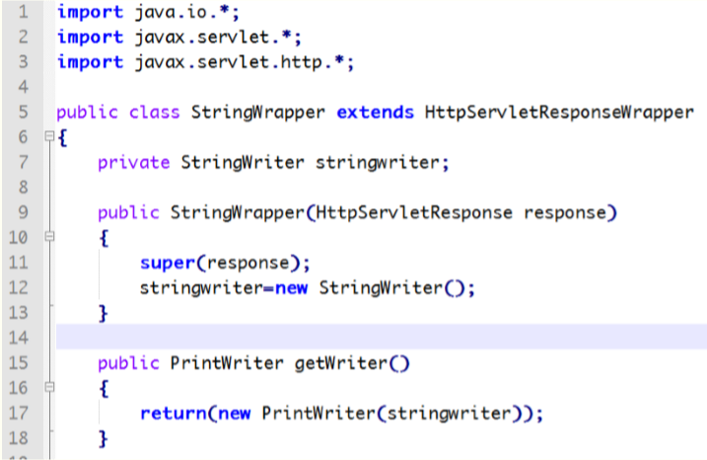
Modifying the response:
Creating our Wrapper Class
Filter
<number>/41

Slide 18
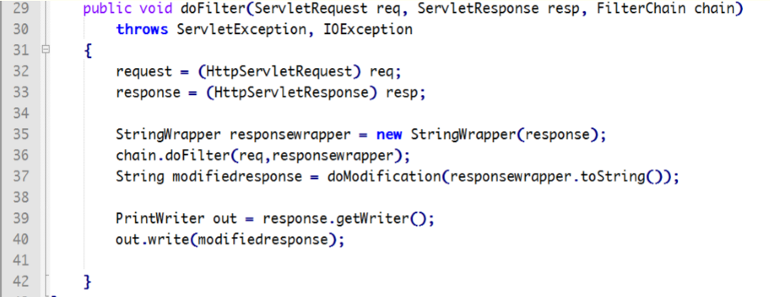
Modifying the response:
In Filter Class
Filter
<number>/41

Slide 19
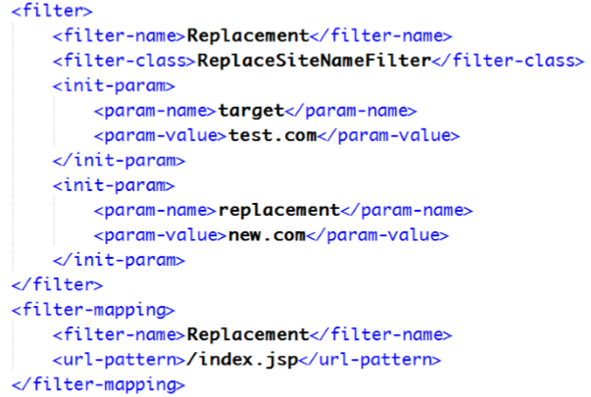
Modifying the response:
In Web.xml
Target will be replace by replacement Test.com will be replace by new.com
Filter
<number>/41

Slide 20
Modifying the response:
Modification Method
Target will be replace by replacement Test.com will be replace by new.com
Filter
<number>/41

Slide 21
Summary
What’s Filter?
What it can be used for ?
How to use Filter?
  Create a basic filter
  Example
  Initialization Parameter in Filter
  Blocking the Response
  Modifying the response
Filter
<number>/41

